Slide 1

Helm Charts Security 101

Slide 2
Agenda
About Me
Helm 3 Basics About Helm Charts
Chart.yaml
values.yaml
Templates
Charts
Helm Chart Security Overview
Signing Charts (Provenance)
Secrets Management Tools
RBAC
Certificates
Using a Trusted Source
Dependency Management
CVEs
Mitigation
Today, we’ll discuss Helm charts, commands, best practices, and tools from the community that help automate security in Helm and Kubernetes.
Why use trusted registries, how to keep your dependencies safe, and and how chart authors can provide mitigation details for their consumers.
Blueprint for Helm Security

Slide 3

Graduating to Helm 3

Slide 4

Helm is a Package Manager for Kubernetes
Helm is a package manager for Kubernetes which helps users create templated packages called Helm Charts to include all Kubernetes resources that are required to deploy a particular application.
Helm then assists with installing the Helm Chart on Kubernetes:
Install
linting
status
test
verify
deploy
upgrade
rollback

Slide 5
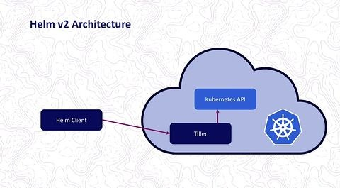
Helm 2 vs Helm 3
Tiller was removed in Helm 3:
Removal of Tiller

Slide 6
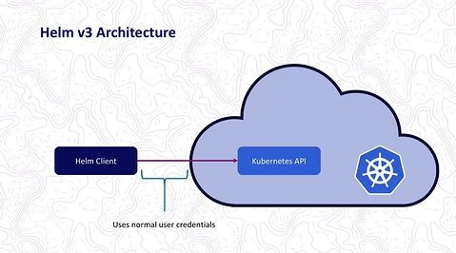
Helm 2 vs Helm 3
Helm 3 interacts directly with the Kubernetes API
Role Based Access Controls

Slide 7
Here are more improvements to Helm 3:
Dependencies: used to live in a requirements.yaml file, but are now part of the Chart.yaml file.
Releases in namespaces
Three-way strategic merge patch OCI Registries for charts
Chart validation: JSONSchema support is added
Improved CRD support: Kubernetes Custom Resource Definition (CRD) installations
Library charts: a class of charts called “library charts” are introduced in Helm 3

Slide 8
New commands for monitoring
Helm status [RELEASE] Helm ls
Displays the status of the named Lists all the releases release
Helm history [RELEASE]
The history of releases is printed
$ helm history demo-rel
REVISION UPDATED
STATUS
CHART
APP VERSION
DESCRIPTION
1 | Mon Oct 3 10:15:13 2016 | superseded | alpine-0.1.0 | 1.0 | Initial install
2 | Mon Oct 3 10:15:13 2016 | superseded | alpine-0.1.0 | 1.0 | Upgraded successfully
3 | Mon Oct 3 10:15:13 2016 | superseded | alpine-0.1.0 | 1.0 | Rolled back to 2
4 | Mon Oct 3 10:15:13 2016 | deployed | alpine-0.1.0 | 1.0 | Upgraded successfully

Slide 9
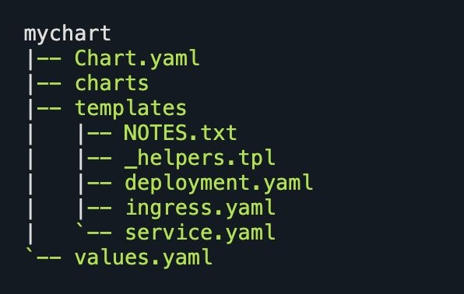
Helm 3 Charts
Chart.yaml Charts Templates values.yaml
Helm Charts Summary
When you publish a Helm chart, you can take care of all the security issues beforehand.
Helm holds the final package with all of your previously approved configuration options and pieces in place and creates an immutable way to manage security with each chart version and each build being tracked.

Slide 10
Helm Charts 101

Slide 11
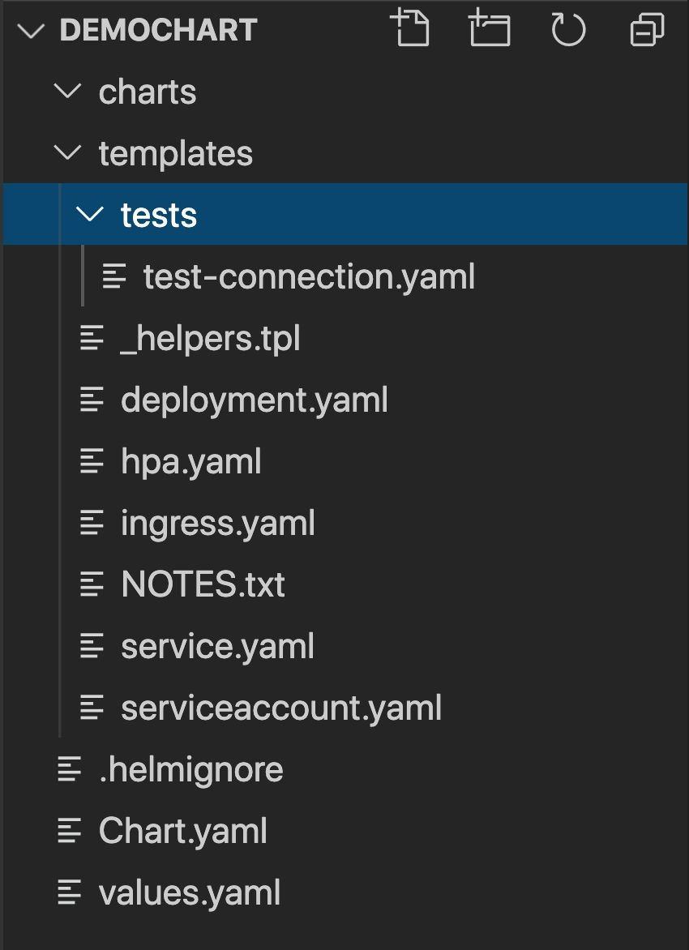


Demo Chart
charts
templates
Chart.yaml
values.yaml

Slide 12
Chart.yaml
This is where metadata about the chart lives. You also declare dependencies here.
apiVersion: v2 name: demochart
description: A Helm chart for Kubernetes
type: application version: 0.1.0
appVersion: 1.16.0
dependencies:
name: nginx version: "1.2.3"
repository: "https://example.com/charts"
name: memcached version: "3.2.1"
repository: "https://another.example.com/charts"

Slide 13
values.yaml
This is where you define your configurations options for each deployment
replicaCount: 1
image:
repository: nginx pullPolicy: IfNotPresent
# Overrides the image tag whose default is the chart appVersion. tag: ""
imagePullSecrets: [] nameOverride: "" fullnameOverride: ""
serviceAccount:
# Specifies whether a service account should be created create: true
# Annotations to add to the service account annotations: {}
# The name of the service account to use.
# If not set and create is true, a name is generated using the fullname template name: ""
podAnnotations: {} podSecurityContext: {}
# fsGroup: 2000

Slide 14
Templates Folder
This is where Helm finds the YAML definitions
service.yaml deployment.yaml hpa.yaml Ingress.yaml Serviceaccount.yaml helpers.tpl NOTES.txt

Slide 15
service.yaml
Here you define your set of services for the pods in Kubernetes
apiVersion: v1 kind: Service metadata:
name: {{ include "demochart.fullname" . }} labels:
{{- include "demochart.labels" . | nindent 4 }} spec:
type: {{ .Values.service.type }} ports:
- port: {{ .Values.service.port }} targetPort: http
protocol: TCP name: http
selector:
{{- include "demochart.selectorLabels" . | nindent 4 }}

Slide 16
deployment.yaml
Generates the metadata of your deployment
apiVersion: apps/v1 kind: Deployment metadata:
name: {{ include "demochart.fullname" . }} labels:
{{- include "demochart.labels" . | nindent 4 }} spec:
{{- if not .Values.autoscaling.enabled }} replicas: {{ .Values.replicaCount }}
{{- end }} selector:
matchLabels:
{{- include "demochart.selectorLabels" . | nindent 6 }} template:
metadata:

Slide 17
Charts folder
demochart/ Chart.yaml values.yaml charts/ templates/
...
The charts/ directory contains subcharts

Slide 18
Helm Security Overview

Slide 19
The Helm community is developing expertise with a number of built-in processes that can help with security
SHA and Checksums
Signatures and signing charts (GPG) Provenance Files and Helm Verify Secrets Management Tools
RBAC and Service Accounts POD Security Policies Network Security
Image security and subcharts
Cert-Manager for certificate signing
Helm lint
CVE Information
Mitigation Notes

Slide 20
Creating a Helm Chart

Slide 21
first...minikube
Minikube is a tool that quickly sets up Kubernetes locally. Minikube runs a single-node Kubernetes cluster inside a Virtual Machine for users looking to try out Kubernetes or develop with it day-to-day.
https://tech.paulcz.net/blog/getting-started-with-helm/
brew install hyperkit
https://minikube.sigs.k8s.io/docs/drivers/hyperkit/

Slide 22
Steps
Helm create demochart
Create a chart
Define services
Sign the chart
Verify the chart’s provenance
Secrets Management (encode and enrypt)
Helm Lint | Helm Status | Helm History

Slide 23
Set Resource Quotes!
apiVersion: v1 kind: ResourceQuota metadata:
name: mem-cpu-demo
spec:
hard:
requests.cpu: "1" requests.memory: 1Gi limits.cpu: "2" limits.memory: 2Gi

Slide 24


Navigating Security with Helm
Chart Hashes
Certificates
Signing Charts
RBAC and Service Accounts
Verifying Charts (Provenance)
POD Security
Secrets Management
Dependencies
Helm Lint

Slide 25
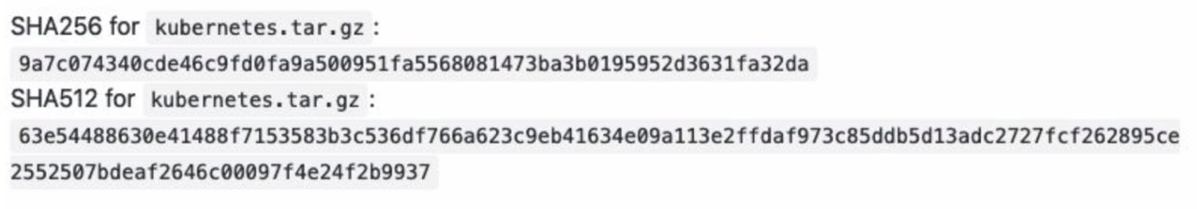
SHA-256 and SHA-512 Hash as a Checksum

Slide 26
Navigating Security
Chart Hashes
Certificates
Signing Charts
RBAC and Service Accounts
Verifying Charts (Provenance)
POD Security
Secrets Management
Dependencies
Helm Lint and Helm Status

Slide 27
Chart signing and helm verify

Slide 28
Signing with GnuPGP Signature
brew install gpg
helm plugin install https://github.com/technosophos/helm-gpg

Slide 29
Create the public-private key
gpg --gen-key
Keyname: demokey
pub rsa2048 2020-07-21 [SC] [expires: 2022-07-21]
DBA3 F0A7 F87B D112 800D A50A 388E B5D0 D62C 07FF
uid [ultimate] demokey <deepd@jfrog.com> sub rsa2048 2020-07-21 [E] [expires: 2022-07-21]

Slide 30
Sign the chart with:
Helm package --sign --key ‘demokey’ --keyring ~/.gnupg/secring.gpg demochart
GNUPG 2.1
Use the following command to transfer your keys into the old file format:
gpg --export-secret-keys >~/.gnupg/secring.gpg

Slide 31
You’ve signed and created a provenance ﬁle to track lineage:
demochart-0.1.0.tgz demochart-0.1.0.tgz.prov

Slide 32
Navigating Security
Chart Hashes
Certificates
Signing Charts
RBAC and Service Accounts
Verifying Charts (Provenance)
POD Security
Secrets Management
Dependencies
Helm Lint

Slide 33
Helm verify
helm verify demochart-0.1.0.tgz
Signed by: demokey (demokey) <demokey@gmail.com>
Using Key With Fingerprint: 1CFE2BD91BD3847C@9743661D82D917761CFEA75 Chart Hash Verified: sha256:471c655ef1d4de91a782ecfcb2a83aeee341e8fc786ebfd9ee34d682f3895e0

Slide 34
Navigating Security
Chart Hashes
Certificates
Signing Charts
RBAC and Service Accounts
Verifying Charts (Provenance)
POD Security
Secrets Management
Dependencies
Helm Lint

Slide 35
Secrets Management
Don’t store sensitive information (passwords, authentication credentials, API keys...) in ConﬁgMaps
Secrets
Sensitive data
ConfigMaps
Key:value pairs that not intended to be hidden

Slide 36
env:
- name: MYSQL_ROOT_PASSWORD
valueFrom: secretKeyRef:
name: mariadb-root-password key: password
These are secret!

Slide 37
Encrypting Secrets
helm plugin install https://github.com/futuresimple/helm-secrets

Slide 38
Helm Secrets Plugin
Usernames, Passwords, Database Credentials, API Tokens, TLS Certiﬁcates
We end up putting this in plain text in many diﬀerent places

Slide 39
$ gpg --generate-key
$ gpg —-fingerprint
pub rsa2048 2020-07-21 [SC] [expires: 2022-07-21]
DBA3 F0A7 F87B D112 800D A50A 388E B5D0 D62C 07FF
uid [ultimate] demokey <demokey@gmail.com> sub rsa2048 2020-07-21 [E] [expires: 2022-07-21]

Slide 40
brew install sops

Slide 41
helm_vars
Create a ﬁle .sops.yaml inside helm_vars folder.
secrets.yaml diff=sopsdiffer secrets.*.yaml diff=sopsdiffer
creation_rules:
-pgp:"DBA3 F0A7 F87B D112 800D A50A 388E B5D0 D62C 07FF"
Sops step

Slide 42
helm plugin install: https://github.com/zendesk/helm-secrets

Slide 43
Create a ﬁle secrets.yaml inside helm_vars folder. Supply with our key pair value in plain text.
mysecret:pAssw0rd
Lets encrypt our secrets.yaml using Helm-secret plugin.
$ helm secrets enc ~/helm_vars/secrets.yaml
Encrypting secrets.yaml Encrypted secrets.yaml

Slide 44
mysecret:ENC[AES256_GCM,data:sxfEX+kK0U4=,iv:55BozyMoAIB8dD7i3JcOtlzQO6gkwVfSx90 J+27y/SY=,tag:mCHsxJVdFxZ6h9mfkcAG8A==,type:str]
sops:
kms:[] gcp_kms:[] azure_kv:[]
lastmodified:'2019-08-20T13:40:56Z' mac:ENC[AES256_GCM,data:28KV+jAT+L7lZSTiIJTL7XC5XvPH4Vzc3R/P/KOdUwBoLBt8Ozo9Z6qQ
Mn4QI6XBYhS127GhD9xOLwMnzjm1yEXxM1dRUpy68jzczDghmUXJx494ZK4klIGEDoQLMaGI6s4rAQoa flix8Tewo3H0ZmQH4P3H/oxcPhRURJY2qns=,iv:f6ZY1L5/Dg9zcIwO5CO8RZ3weQXsHa4+ufkf/iM3 GUo=,tag:ivGMwTGyG27JnbQLzsTlXA==,type:str]
pgp:
-created_at:'2019-08-20T13:40:54Z'
enc:|
-----BEGINPGPMESSAGE-----
hQEMA94e2vEPuuuwAQf/fj/fbhRG7w9OeqAmyMKu6UQzEA7HD54287WGbNSmihAc SgGsUpcgPLRLPO+n2MOrHLlPdx15gUIFfE7q6y1POcYJmTCHiolNDigQFSQj5mQZ rZ3xT0kzjcrOw8q0HUoHcKgQsn7jQr3Y3MX3z/63wq9jW2lDCqoYk61s7z5SUKLD J13Q+TUvCEXVfkjO/n2lmuSEgV7rmc5Gq5GkQ3o07hbcJTmCXkapo/s11I4oRMjw ssxz1psquvx8awKG/SfVhmVllRCIQTINDhCGUHhAqPHhDQ/v79Akh4Snk6Q2Pxfw QcWJsJvYCMyU68F28j3SNOKkqtHcDOGNSWMATj8+b9JcAZqFXGBjxHdSFUEUs7GJ
tAOH1uBnzW6Jmr3cMluX1mb3YNSG5VYTJ1fmpK/fEgOCZylz91MYt0mMmh+GNVTS IBN5Z/7V3HAGL24Sq8/+SNB9OZGecyD29Xhcxlw=
=vSV3
-----ENDPGPMESSAGE----- fp:1189AF85735D53F1285FBBD59EE16A2EC4F2E8FB

Slide 45

You can also use Hashicorp Vault for advanced Secrets Management
https://www.vaultproject.io/

Slide 46
Navigating Security
Chart Hashes
Certificates
Signing Charts
RBAC and Service Accounts
Verifying Charts (Provenance)
POD Security
Secrets Management
Dependencies
Helm Lint

Slide 47
Helm lint
helm lint demochart
==> Linting demochart
[INFO] Chart.yaml: icon is recommended
1 chart(s) linted, 0 chart(s) failed

Slide 48
Navigating Security
Chart Hashes
Dependencies
Signing Charts
Certificates
Verifying Charts (Provenance)
RBAC and Service Accounts
Secrets Management
POD Security
Helm Lint

Slide 49
Pod Security Policies
PodSecurityPolicy (PSP) admission controller
kubectl create -f your-new-policy.yaml
When you enable Pod Security Policies, you can control things like:
The running of privileged containers
Use of host namespaces
Use of host networking and ports
Use of volume types
Use of the host filesystem
A whitelist of Flexvolume drivers
The allocation of an FSGroup that owns the pod’s volumes
Requirements for use of a read only root file system
The user and group IDs of the container
Escalations of root privileges

Slide 50
Disable privileged containers
apiVersion: policy/v1demobeta1 kind: PodSecurityPolicy metadata:
name: prevent-privileged-containers spec:
privileged: false
https://resources.whitesourcesoftware.com/blog-whitesource/kubernetes-pod-security-policy

Slide 51
Read-only file system
apiVersion: policy/v1demobeta1 kind: PodSecurityPolicy metadata:
name: read-only-fs spec:
readOnlyRootFilesystem: true
https://resources.whitesourcesoftware.com/blog-whitesource/kubernetes-pod-security-policy

Slide 52
Prevent privilege escalation
apiVersion: policy/v1demobeta1 kind: PodSecurityPolicy metadata:
name: no-privilege-escalation spec:
allowPrivilegeEscalation: false
https://resources.whitesourcesoftware.com/blog-whitesource/kubernetes-pod-security-policy

Slide 53
Prevent containers from running as root
apiVersion: policy/v1beta1 kind: PodSecurityPolicy metadata:
name: no-privilege-escalation spec:
MustRunAsNonRoot: true
https://resources.whitesourcesoftware.com/blog-whitesource/kubernetes-pod-security-policy

Slide 54
Group your policies together
apiVersion: policy/v1beta1 kind: PodSecurityPolicy metadata:
name: example spec:
privileged: false spec:
readOnlyRootFilesystem: true spec:
allowPrivilegeEscalation: false spec:
MustRunAsNonRoot: true
https://resources.whitesourcesoftware.com/blog-whitesource/kubernetes-pod-security-policy

Slide 55
Network Policies
To limit the access to the nginx service so that only Pods with the label access: true can query it, create a NetworkPolicy object as follows:
apiVersion: networking.k8s.io/v1 kind: NetworkPolicy
metadata:
name: access-nginx spec:
podSelector: matchLabels:
app: nginx ingress:
- from:
- podSelector: matchLabels:
access: "true"

Slide 56
Navigating Security
Chart Hashes
Dependencies
Signing Charts
Certificates
Verifying Charts (Provenance)
RBAC and Service Accounts
Secrets Management
POD Security
Helm Lint

Slide 57
Let’s talk about Pods
The desired state of each cluster and access privileges within each node is highly conﬁgurable. For example, namespaces and service accounts can be used to divide the cluster’s resources to multiple users and grant unique permissions within each group.
Even pods have security features that can be activated with the admission controller and by assigning unique privileges to users and groups using Role-Based Access Control (RBAC).

Slide 58
RBAC
Role
ClusterRole RoleBinding ClusterRoleBinding
(ServiceAccount, User or Group)

Slide 59
Service Accounts
Who is the user working within the pod?
rbac:
create: true
serviceAccounts: client:
create: true name:
server: create: true name:
Service accounts are tied to a set of credentials are mounted into pods allowing in-cluster processes to talk to the Kubernetes API.
API requests are tied to either a normal user or a service account.

Slide 60
Navigating Security
Chart Hashes
Dependencies
Signing Charts
Certificates
Verifying Charts (Provenance)
RBAC and Service Accounts
Secrets Management
POD Security
Helm Lint

Slide 61
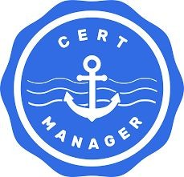
We need to install cert-manager to do the work with Kubernetes to request a certiﬁcate and respond to the challenge to validate it.
We can use Helm to install cert-manager.

Slide 62
Cert-Manager

Slide 63
Let’s use cert-manager by Jetstack for TLS

Slide 64
Install Cert-Manager using Helm Charts

Slide 65
TLS with Cert-Manager
Then you’ll need to get a TLS certificate by installing cert-manager:
# Install the CustomResourceDefinition resources separately:
$ kubectl apply --validate=false -f
https://github.com/jetstack/cert-manager/releases/download/v0.15.0/cert-manager.crds.yaml
# Create the namespace for cert-manager:
$ kubectl create namespace cert-manager
# Install the cert-manager Helm chart from ChartCenter:
$ helm install cert-manager center/jetstack/cert-manager You can do a final rollout status check with:
$ kubectl -n cert-manager rollout status deploy cert-manager

Slide 66
Navigating Security
Chart Hashes
Dependencies
Signing Charts
Certificates
Verifying Charts (Provenance)
RBAC and Service Accounts
Secrets Management
POD Security
Helm Lint

Slide 67
Last Item: Checking Dependencies
Image security and sub-charts

Slide 68
More...
Helm Charts Summary
demochart/ Chart.yaml values.yaml charts/ templates/
...
The charts/ directory contains subcharts

Slide 69
Creating a subchart
$ cd demochart/charts
$ helm create mysubchart
Creating mysubchart
$ rm -rf mysubchart/templates/*.*

Slide 70
Checking Dependencies (Image Security and Subcharts)

Slide 71
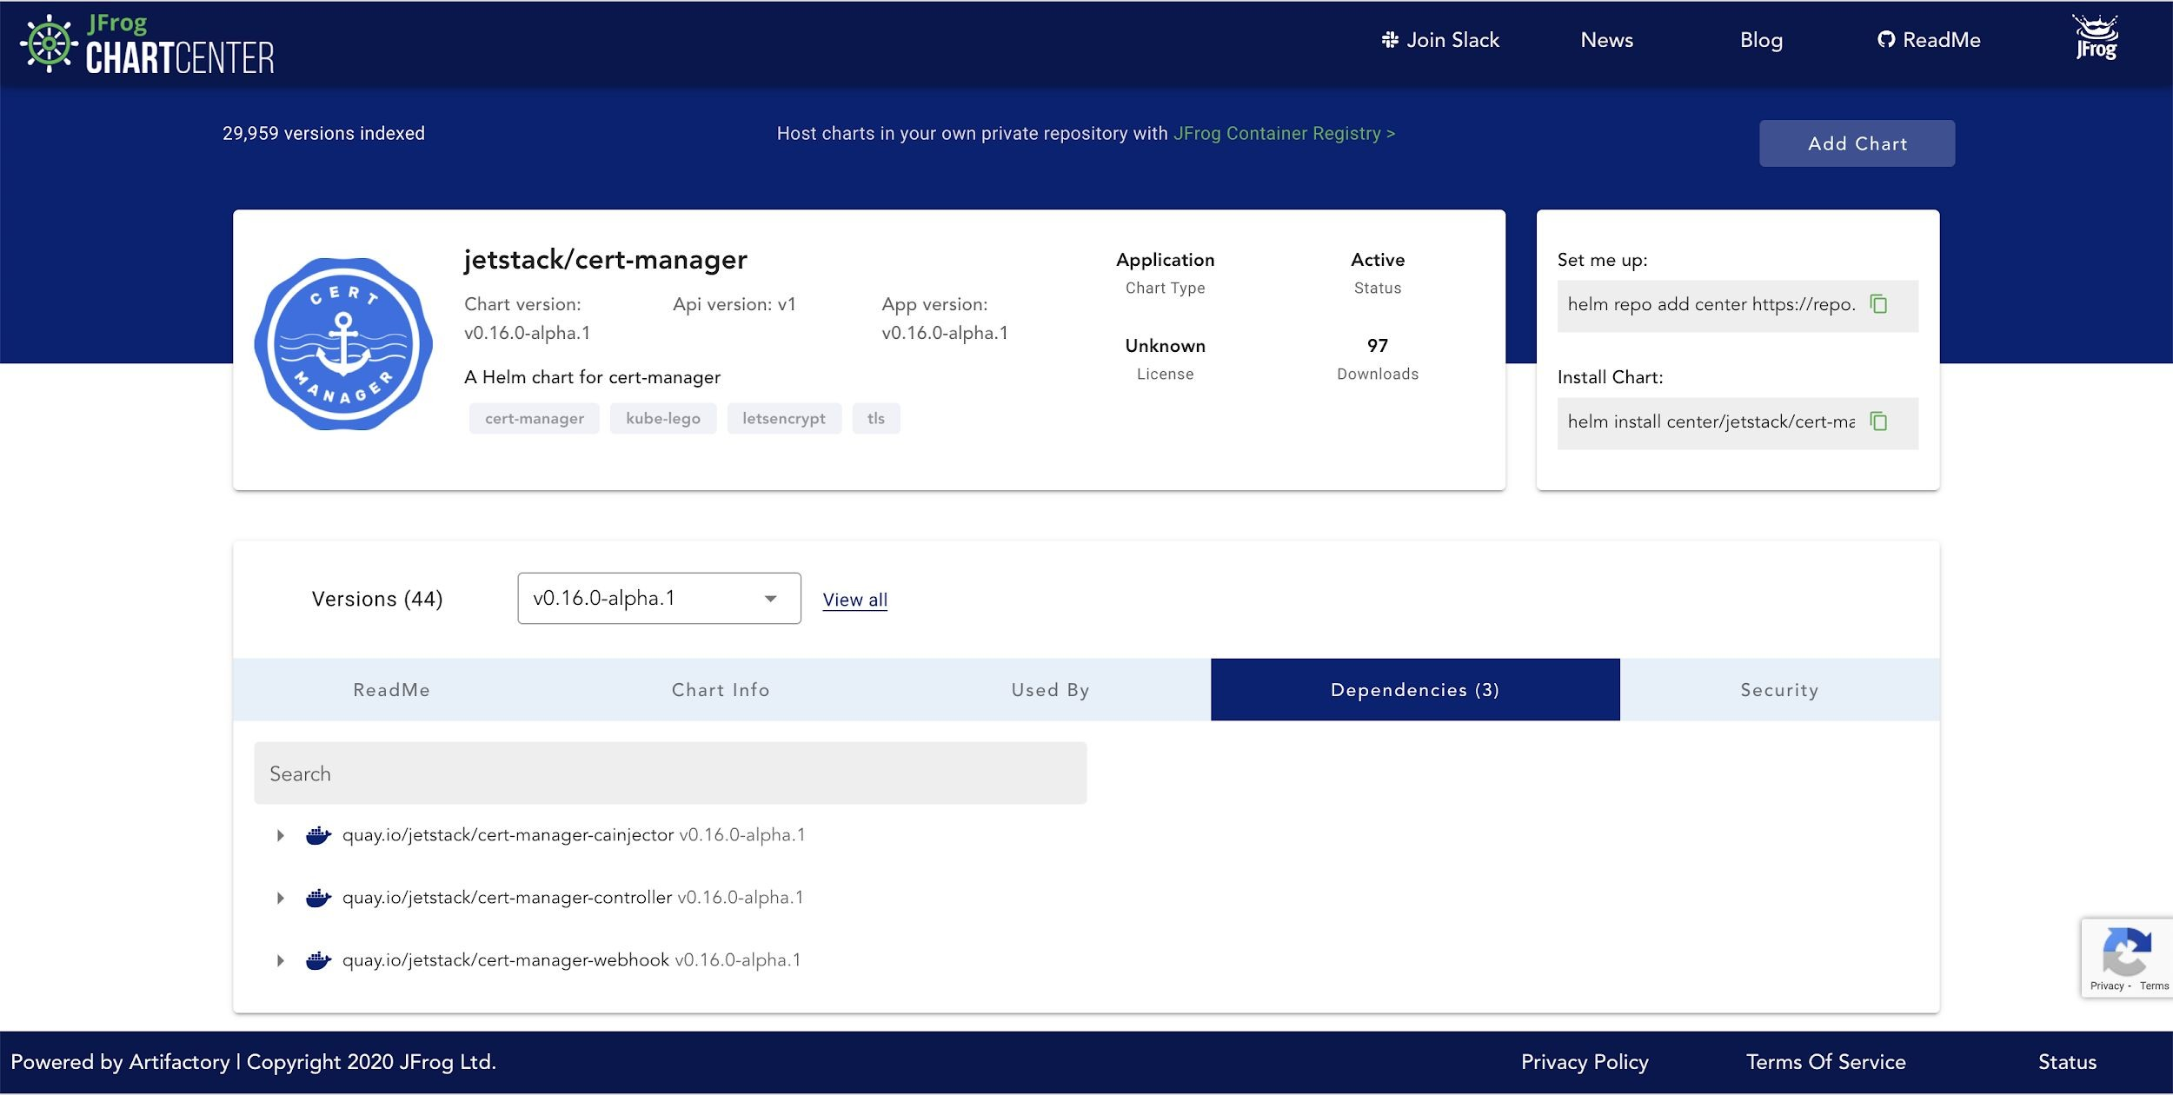
ChartCenter

Slide 72
CVE and Mitigation with JFrog ChartCenter

Slide 73
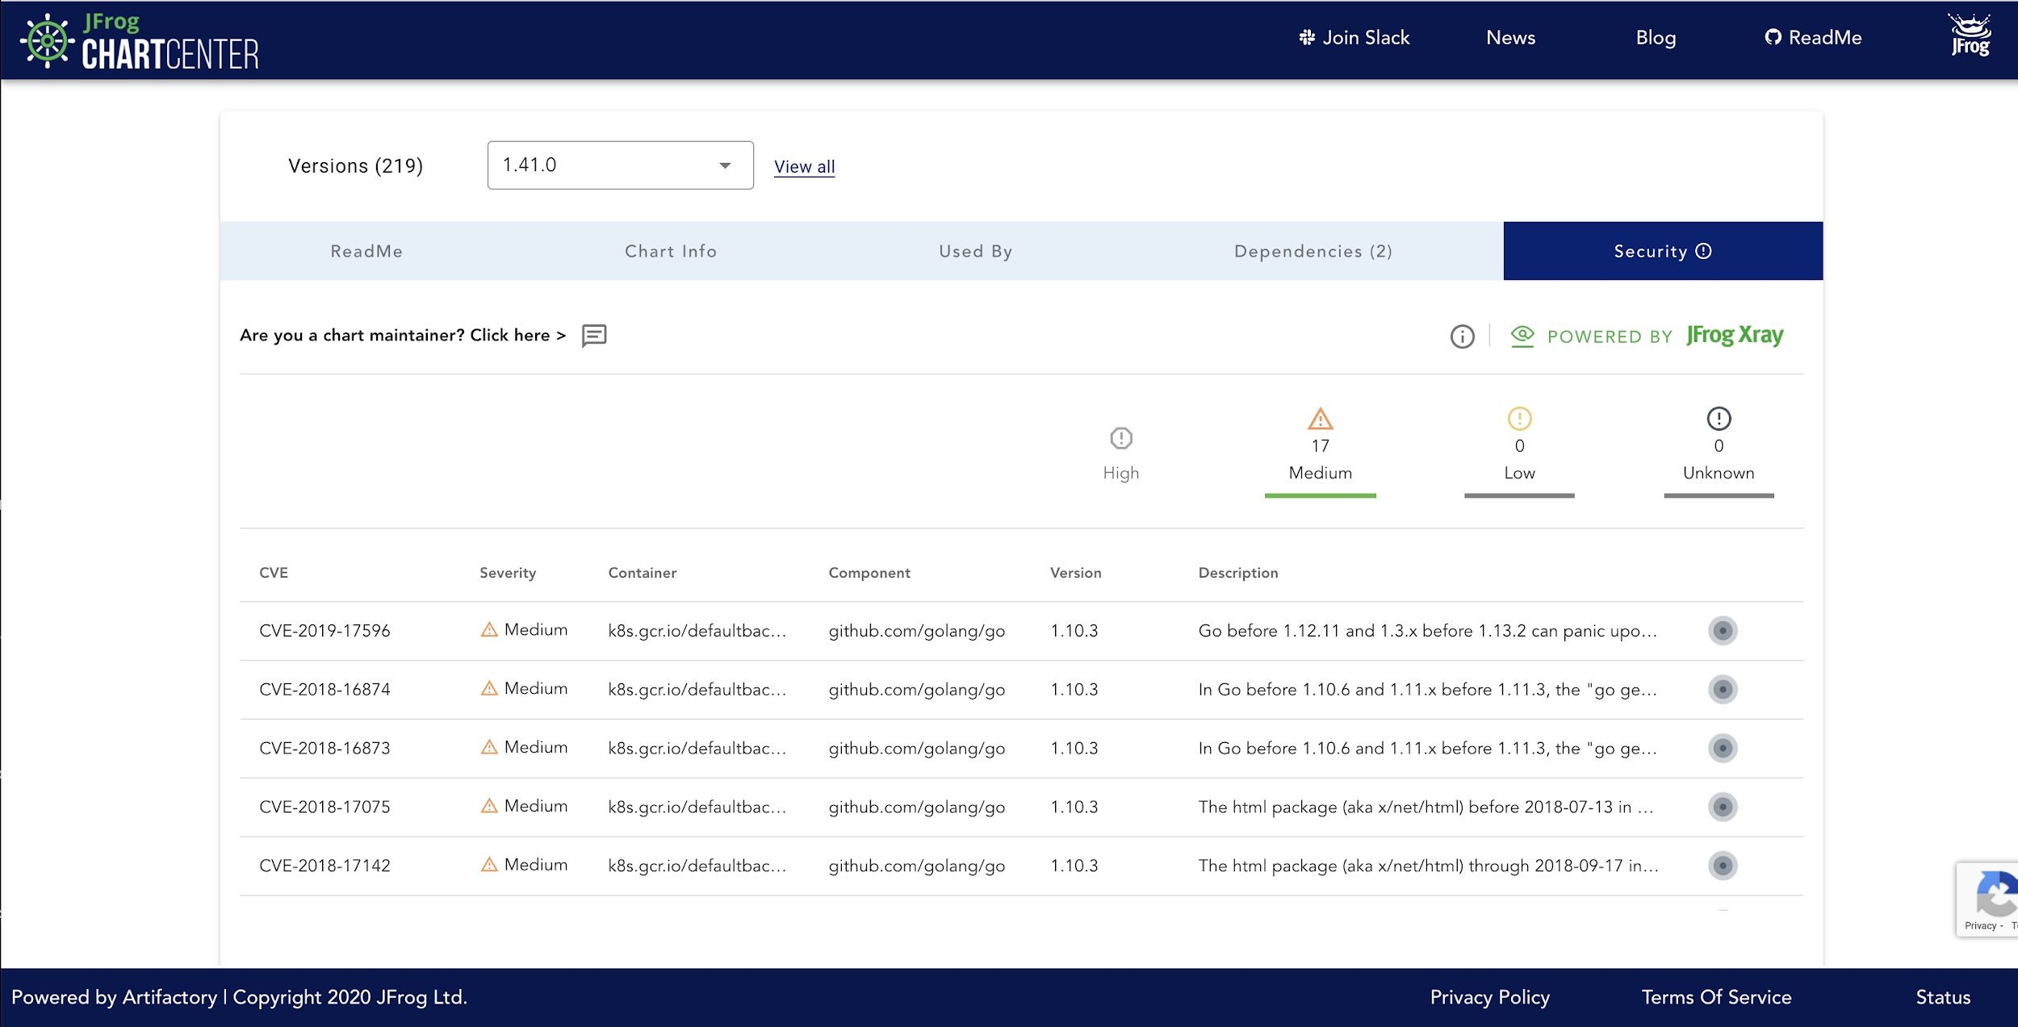
ChartCenter Security Tab

Slide 74
For Chart Maintainers, Introducing:
security-mitigation.yaml

Slide 75
Here is the spec:
https://github.com/jfrog/chartcenter/blob/master/docs/security-mitigation.yaml
## Schema version of this YAML file
schemaVersion: v1
## Overall mitigation summary
summary: text
## External URL if you'd like to link to an external page
securityAdvisoryUrl: URL
## If you want to point us to a file instead of filling out the CVE's here
useMitigationExternalFile: boolean mitigationExternalFileUrl: URL
## Mitigation notes for individual CVEs
mitigations: cves:
## Indicates package Uri for which the security mitigation is provided. helm://… || docker://…
affectedPackageUri:
## Which chart versions this cve note belongs to
affectedVersions: mastermind SemVer constraint
## Description / note
description: text

Slide 76
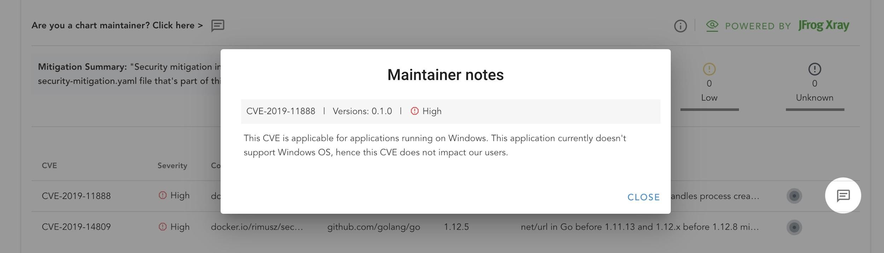
Here is an example of what these notes look like on ChartCenter

Slide 77
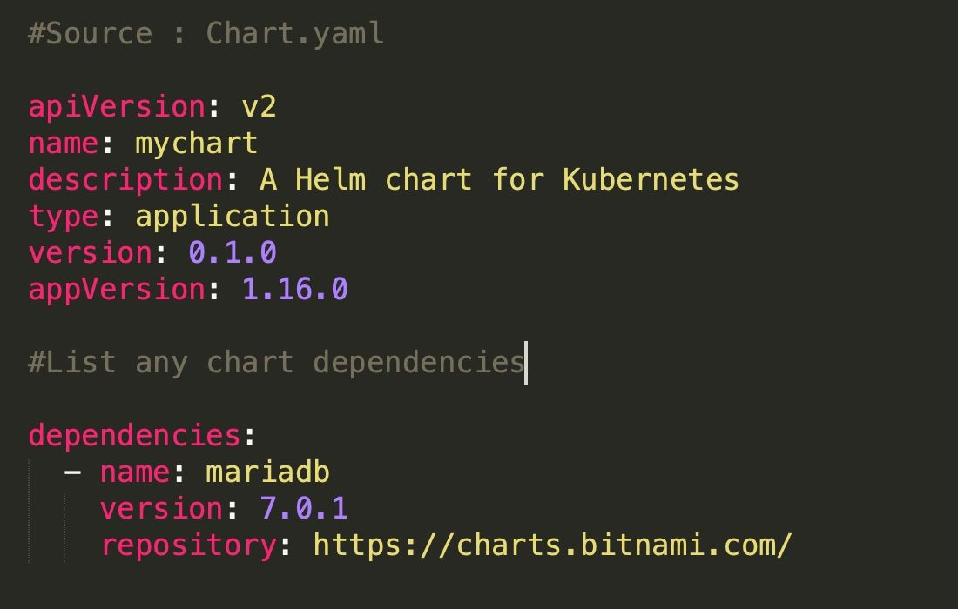

How charts create reproducible security
Organizations do not have to replicate each security step.
If teams are distributed throughout the world and have multiple environments, such as test, QA, staging and production.
Feat Test
QA
Stage
Immutable Conﬁgurations can be shared
Prod
Chart version: 1.5.1

Slide 78
Deploying a chart

Slide 79
Debugging
helm lint is your go-to tool for verifying that your chart follows best practices
helm install --dry-run --debug or helm template --debug: We've seen this trick already. It's a great way to have the server render your templates, then return the resulting manifest file.
helm get manifest

Slide 80
Build and Deploy
$ helm install my-demo-chart demochart/ --values demochart/values.yam
l
Release “my-demo-chart” has been upgraded. Happy Helming!

Slide 81
Wrapping Up: Blueprint for Security

Slide 82
Navigating Security
Chart Hashes
Certificates
Signing Charts
RBAC and Service Accounts
Verifying Charts (Provenance)
POD Security
Secrets Management
Dependencies
Helm Lint

Slide 83
Starting a Blueprint for Security
When creating a chart
Signing a chart with gpg
Verification (Provenance and SHA256) Encrypting secrets
Helm lint
Certificates Permissions with RBAC
Pod Security Policy (PSP)
Linting and Debugging
Using a trusted repository
Helm repo add...
Checking dependencies CVE Information Reviewing Mitigation Notes

Slide 84
Chartcenter.io
$ helm repo add center https://repo.chartcenter.io
$ helm repo update
Next, you can use this command to see a list of all the charts available in ChartCenter:
$ helm search repo center/
To check a specific Helm repository, you can use something like this:
$ helm search repo center/jfrog
$ helm install jfrog center/jfrog/artifactory-jcr

